Slide 1
‘The answer lies in the soil’
Arthur Fallowfield
(aka Kenneth Williams)
‹#›
Notes:
‹#›

Slide 2
Soil
What is it?
Where does it come from?
What does it do?
What do plants need from it?
What happens if things go wrong?
‹#›
Notes:
BASIS 2003 - NUTRIENT UPTAKE AND DEFICIENCY
‹#›

Slide 3
Origins of soil
Weathering of underlying rocks
  Igneous rocks e.g. granite
  Sedimentary rocks e.g. chalk, limestone
  Metamorphic rocks e.g. slate, marble
Alluvial deposits
    rivers
    lakes
    glaciers
‹#›

Slide 4
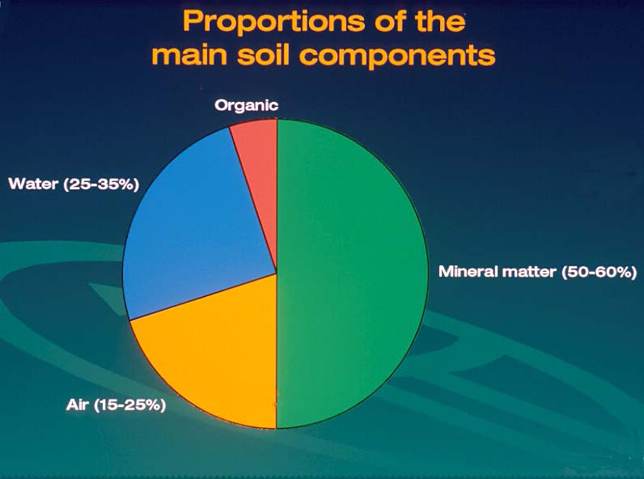
‹#›
Notes:
BASIS 2003 - NUTRIENT UPTAKE AND DEFICIENCY
‹#›

Slide 5
Functions of the soil
Soils have physical, chemical and biological properties that influence plants
To provide anchorage for the plant
To provide adequate air spaces to allow root respiration
To hold sufficient available water for the plant
To hold sufficient available nutrients for the plant
‹#›
Notes:
BASIS 2003 - NUTRIENT UPTAKE AND DEFICIENCY
‹#›

Slide 6
Physical aspects of soil
Determined by the size and shape of soil particles and how they interlock
Larger gaps are filled with air
Smaller gaps are filled with water
Some substrates hold air/water within the actual particles (perlite)
Particle size analysis gives % by weight of particles in each size category
‹#›
Notes:
BASIS 2003 - NUTRIENT UPTAKE AND DEFICIENCY
‹#›

Slide 7
Soil texture
Particle sizes
< 0.002 mm - Clay
0.002 - 0.06mm - Silt
0.06 - 2.0 mm - Sand
(> 2.0mm - gravel)
‹#›

Slide 8
Assessing soil texture
Hand texturing: Moist soil rubbed between fingers - sand particles feel gritty, silt feels silky, clay feels sticky
Particle size distribution: % sand, silt and clay
Sandy soils hold less water and nutrients than clay soils
‹#›
Notes:
BASIS 2003 - NUTRIENT UPTAKE AND DEFICIENCY
‹#›

Slide 9
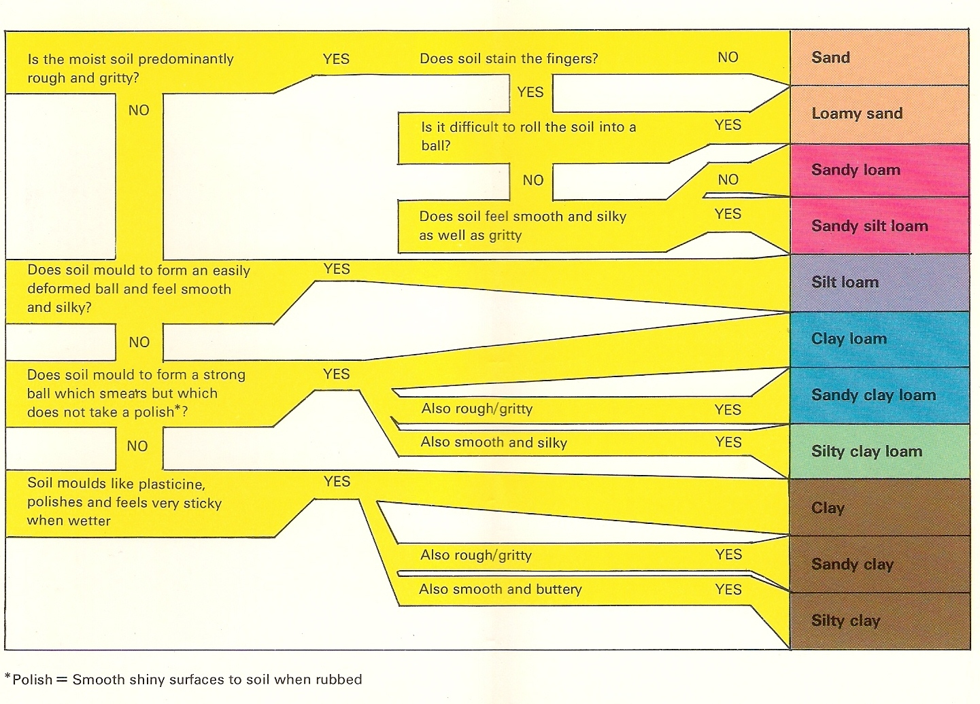
Assessing soil texture
‹#›

Slide 10
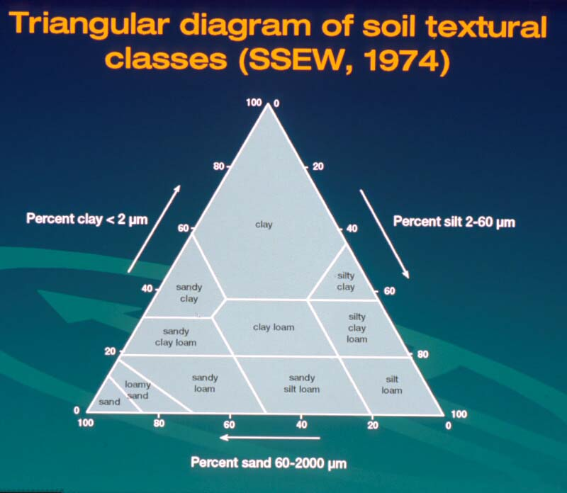
‹#›
Notes:
BASIS 2003 - NUTRIENT UPTAKE AND DEFICIENCY
‹#›

Slide 11
Soil texture effects
Air capacity (AFP )
    Sand
    Silt
    Clay
Water capacity
    Clay
    Silt
    Sand
Nutrient capacity
    Clay
    Silt
    Sand - leaching
‹#›

Slide 12
Available Water Capacity (AWC)
Topsoil Subsoil (mm/10cm depth)
Sand 8 5
Sandy loam 17 15
Silt loam 22 21
Clay loam 18 15
Clay 18 15
Peats 35 35
‹#›
Notes:
BASIS 2003 - NUTRIENT UPTAKE AND DEFICIENCY
‹#›

Slide 13
Water
Water uptake
  Osmosis into roots
  Transported through the xylem
  Transpiration from leaves through stomata
  One hectare of crop can transpire 60,000 litres (60 tonnes) of water per day
‹#›
Notes:
BASIS 2003 - NUTRIENT UPTAKE AND DEFICIENCY
‹#›

Slide 14
Nutrient capacity
Clay particles carry a negative charge(⁻)
Cations (bases) have a positive (⁺) charge:
  Calcium (Ca⁺⁺)
  Magnesium (Mg⁺⁺)
  Potassium (K⁺)
  Sodium (Na⁺)
Clay soils have a high base (or cation) exchange capacity therefore
‹#›

Slide 15
Soil Structure
Soil texture describes the basic mineral components of a soil. How they are aggregated determines the structure.
Soil structure influences how water moves through the soil and must be examined in the field, not on a sample
Poor soil structure may hinder root development, drainage and good nutrient uptake and encourage root diseases
‹#›
Notes:
BASIS 2003 - NUTRIENT UPTAKE AND DEFICIENCY
‹#›

Slide 16
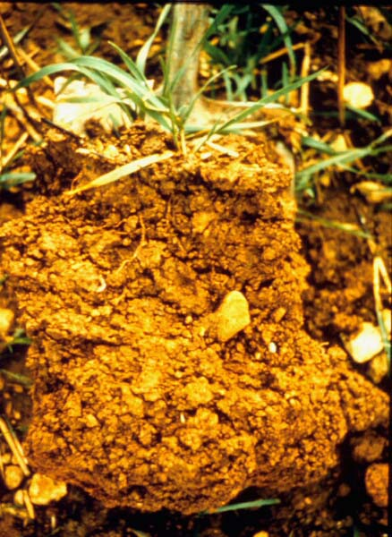
‹#›
Notes:
BASIS 2003 - NUTRIENT UPTAKE AND DEFICIENCY
‹#›

Slide 17
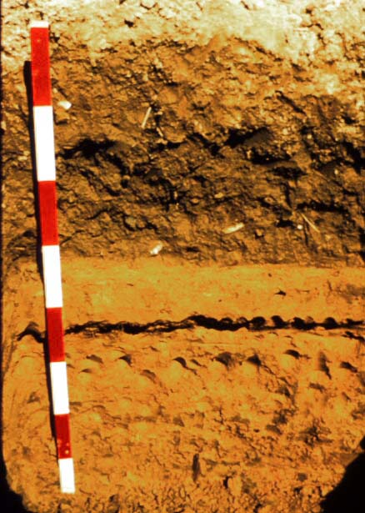
‹#›
Notes:
BASIS 2003 - NUTRIENT UPTAKE AND DEFICIENCY
‹#›

Slide 18
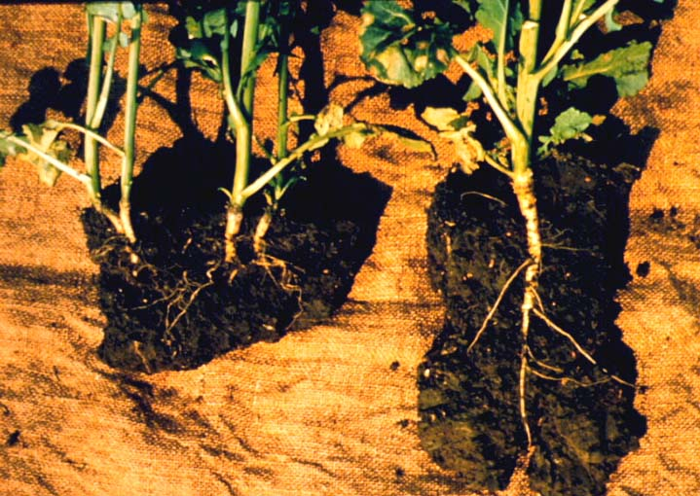
‹#›
Notes:
BASIS 2003 - NUTRIENT UPTAKE AND DEFICIENCY
‹#›

Slide 19
Maintaining Soil Structure
Cultivations
  Type (machine and depth)
  Frequency
  Conditions
Irrigation (capping)
Rotation
  Short term grass leys
Maintaining organic matter
‹#›
Notes:
BASIS 2003 - NUTRIENT UPTAKE AND DEFICIENCY
‹#›

Slide 20
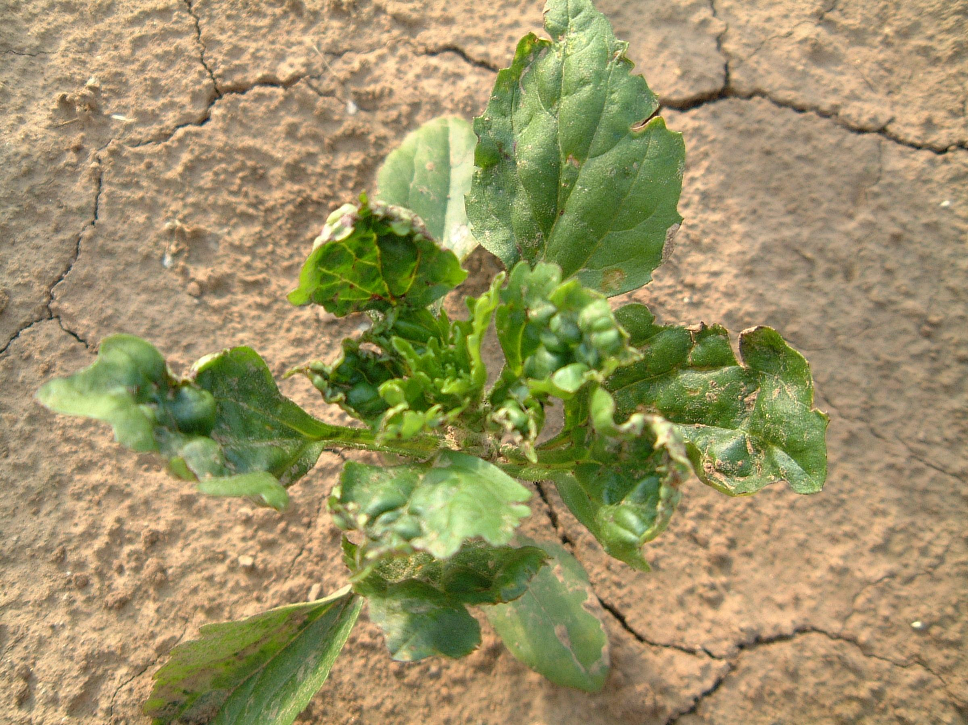
Soil capping
‹#›
Notes:
BASIS 2003 - NUTRIENT UPTAKE AND DEFICIENCY
‹#›

Slide 21
Soil Organic Matter
Most soils can be improved structurally by the addition of organic matter
Organic matter helps to stabilise soil aggregates, improving drainage in heavy soils and moisture holding capacity in sandy soils
Organic matter can be quickly lost by the activity of soil organisms which break it down, especially after cultivations
‹#›
Notes:
BASIS 2003 - NUTRIENT UPTAKE AND DEFICIENCY
‹#›

Slide 22
Alternatives to soil
Peat
Coir (coconut fibre)
Wood waste and bark
Composted green waste
Spent mushroom compost
Mixtures (‘composts’)
Hydroponics
Soil-borne pests and diseases
‹#›

Slide 23
Recycled green waste
Variable ingredients and sources of material
Variable composting treatment
High pH (alkaline)
Herbicide contamination risks
  grass cuttings
  Farm manures (aminopyralid – ‘Forefront’)
‹#›

Slide 24
Plant Mineral Nutrition
Plants need mineral nutrients for
Proteins
Plant structure
Biochemical processes in cells
‹#›
Notes:
BASIS 2003 - NUTRIENT UPTAKE AND DEFICIENCY
‹#›

Slide 25
Plant Nutrients - Essential Elements
Major Nutrients
  Nitrogen (N)
  Phosphorus (P)
  Potassium (K)
  Calcium (Ca)
  Magnesium (Mg)
  Sulphur (S)
Minor Nutrients (Trace Elements)
  Boron (B)
  Copper (Cu)
  Iron (Fe)
  Manganese (Mn)
  Molybdenum (Mo)
  Zinc (Zn)
‹#›
Notes:
BASIS 2003 - NUTRIENT UPTAKE AND DEFICIENCY
‹#›

Slide 26
Nutrient deficiency
Low supply
    Geology
    Soil texture
    Leaching
    Fertiliser application (soil analysis)
    Other sources e.g. sulphur in air
Availability / uptake
‹#›
Notes:
BASIS 2003 - NUTRIENT UPTAKE AND DEFICIENCY
‹#›

Slide 27
Nutrient deficiency
Availability / uptake problems
    pH (alkalinity or acidity)
    Root health
    Soil structure
    Water availability, especially for calcium
    Competition from other elements
    (Soil temperature, humidity, excess demand)
‹#›
Notes:
BASIS 2003 - NUTRIENT UPTAKE AND DEFICIENCY
‹#›

Slide 28
pH pH
A measure of acidity or alkalinity
Scale 1-14
7 = neutral <7 = acid >7 = alkaline
Negative log of H⁺ ion concentration
logarithmic scale : pH 4 = 10 times more acid than pH 5 and 100 x pH 6
Interaction with growing medium:
    Mineral soils
    Organic soils e.g. peat
‹#›
Notes:
BASIS 2003 - NUTRIENT UPTAKE AND DEFICIENCY
‹#›

Slide 29
What does acidity do to plants?
Species dependent
  Ericaceous plants (calcifuge)
  Most vegetables
Mineral soils
  Release toxic amounts of aluminium and manganese at low pH
  Flower colour – Hydrangeas
Peat soils or growing media
  Much less effect, alkalinity more a problem
‹#›

Slide 30
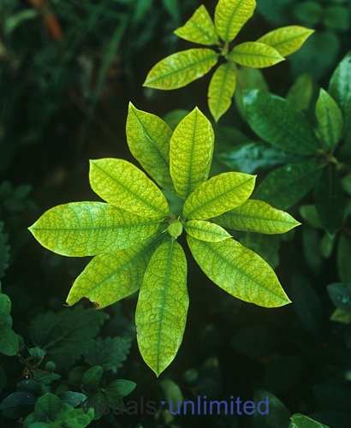
‘Lime induced chlorosis’
‹#›

Slide 31
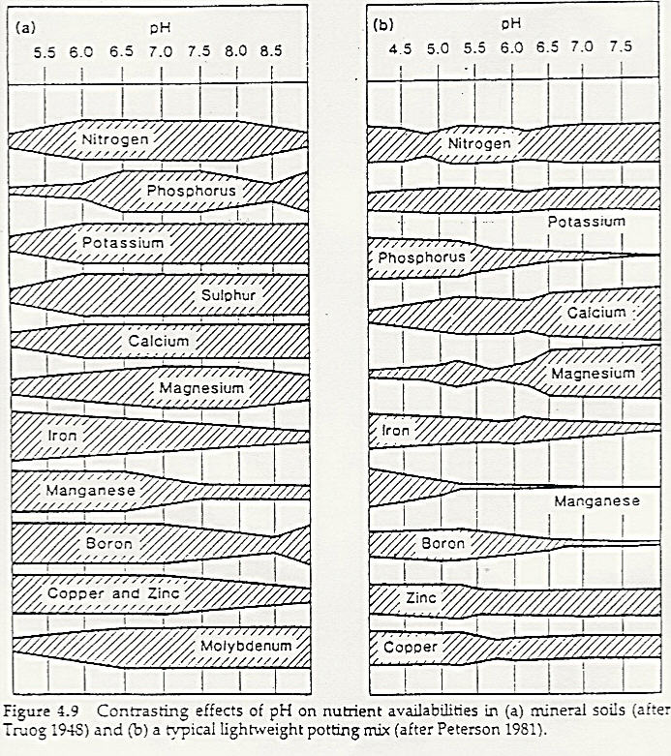
Effect of pH on nutrient availability
Mineral soils Peat mix
‹#›
Notes:
BASIS 2003 - NUTRIENT UPTAKE AND DEFICIENCY
‹#›

Slide 32
pH pH
  Reduced availability at high pH
    Boron
    Copper
    Iron
    Manganese
    Phosphorus
    Zinc
  Reduced availability at low pH
    Molybdenum e.g. whiptail in brassicas
‹#›
Notes:
BASIS 2003 - NUTRIENT UPTAKE AND DEFICIENCY
‹#›

Slide 33
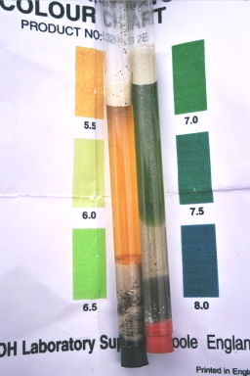
pH test kit
‹#›
Notes:
BASIS 2003 - NUTRIENT UPTAKE AND DEFICIENCY
‹#›

Slide 34
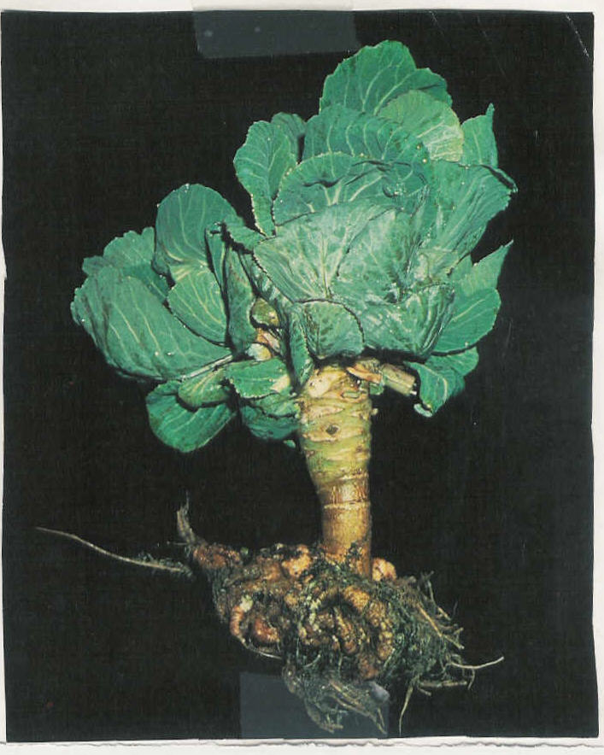
pH and disease
Club root in brassicas
‹#›
Notes:
BASIS 2003 - NUTRIENT UPTAKE AND DEFICIENCY
‹#›

Slide 35
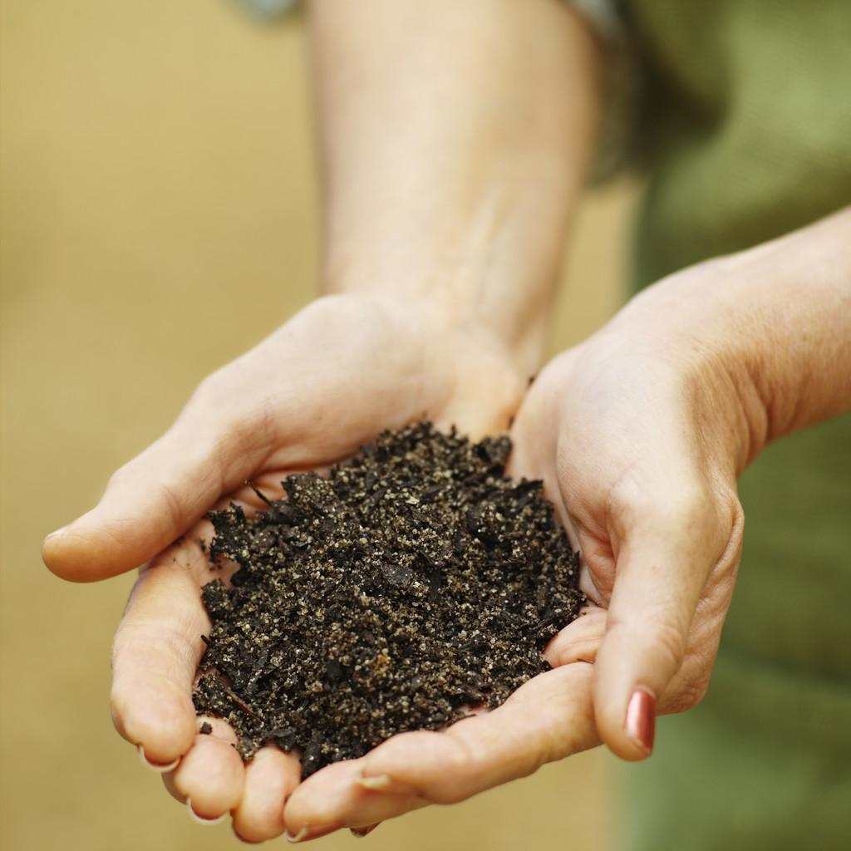
Good gardening!
‹#›

